Slide 1
Welcome to the Jungle
What the Bible says about being prepared.

Slide 2
Learning Objectives
In this 4 week class the student will be made aware of weaknesses in their family survival strategy.
Have opportunity to shore up these weak positions in preparation for natural disasters and possible man made events.
Understand the biblical perspective of preparing for emergency situations.
Understand that your safety is your responsibility and not the Government.

Slide 3
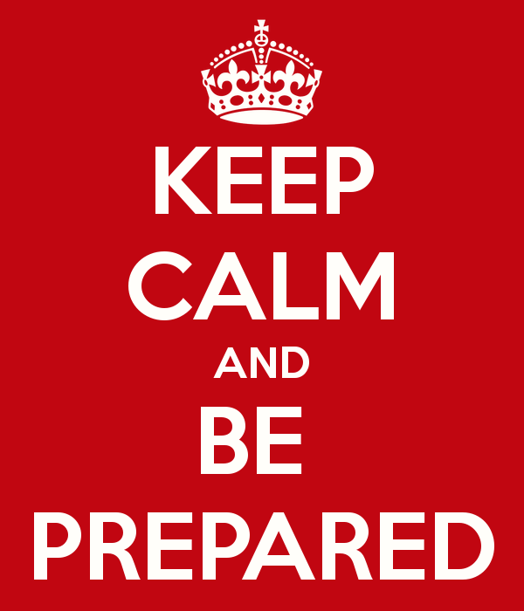
The Proverbs establish preparedness
Proverbs 27:12 A prudent man foreseeth the evil, and hideth himself; but the simple pass on, and are punished.
When you read the word of God, understand prophesy and watch world events you can see how being prepared is a prudent thing to do.
It’s not about losing faith, it’s about trusting God’s word.
As we move into the End Days we do not know exactly what to expect, but we should not put it aside or we seal our punishment.

Slide 4
God told Noah to be Prepared
Genesis 6:21 And take thou unto thee of all food that is eaten, and thou shalt gather it to thee; and it shall be for food for thee, and for them.
God made sure Noah was aware of what to take and how much to take.
Noahs obedience assured he and his family were well provisioned and the animals were also well provisioned.

Slide 5
Fill your Store House
Proverbs 21:20 The wise store up choice food and olive oil, but fools gulp theirs down.
There is nothing foolish about preparing for survival.
We have seen with our most recent snow storm that we can be moved into survival mode from one day to the next.
The time to prepare is not when the storm is upon you.

Slide 6
Don’t let Society Program You
1 Corinthians 16:13 Be on the alert, stand firm in the faith, act like men, be strong.
In todays world the lie of feminism has attempted to emasculate the man from the household. In every tv show the father figures are made to look like bumbling idiots. Men are told that they are weak and this is contrary to the word of God.
There is nothing wrong with both genders having specific God given roles. None of us are equal and in a emergency situation our survival will depend on the specific strengths God has given all of us.

Slide 7
Don’t be a Zombie
1 Thessalonians 5:6 Therefore let us not sleep, as others do, but let us watch and be sober.
Social Media, the news and Hollywood have lulled many to sleep in a false sense of security that everything will be “ok”. In short, many are simply too distracted to notice that the house is on fire.
If you are truly watching, you understand that something is coming.
The things that take place before the Lord returns will require us to “…Endure till the end.” Matt 24:13
If Jesus told us to “Endure” then something must be unfolding that will require a certain amount of preparedness.

Slide 8
Did Jesus Tell us to Prepare?
Supplies for the Road
Luk 22:35 ¶And He said to them, “When I sent you without money bag, knapsack, and sandals, did you lack anything?” So they said, “Nothing.”
Luk 22:36 ¶Then He said to them, “But now, he who has a money bag, let him take it, and likewise a knapsack; and he who has no sword, let him sell his garment and buy one.
Luk 22:37 “For I say to you that this which is written must still be accomplished in Me: ‘And He was numbered with the transgressors.’For the things concerning Me have an end.”
Luk 22:38 ¶So they said, “Lord, look, here are two swords.” And He said to them, “It is enough.”

Slide 9
Yvonne Newton
Originally from Houston, Tx.
Retired From AT&T after 33 years.
Currently / COSA / SAPD Fleet Services.
Lifetime member of Girl Scouts
Taught Outdoor training and survival skills for the Last 30 Years.

