Slide 1
SECURITY BRIEFING
Living in Worst Case Scenario

Slide 2
Learning Objectives
At the end of this lesson the student will have been briefed on the mind set of surviving a critical Incident. Live in Worst Case Scenario.
The student will have the tools necessary to formulate a plan to survive a critical incident.
The student will have the ability to develop the understanding of when to deploy a critical incident plan.

Slide 3
LIVING IN WORST CASE SCENARIO
This Mindset allows you to be ready for Anything, All the Time.
Cover - Concealment

Slide 4
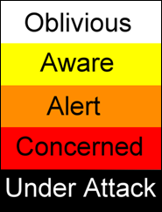
Threat Conditions
Condition White - Home watching TV. Most comfortable for your brain.
Condition Yellow - Walking through a parking Lot
Condition Orange - You see a shady Character walking towards you in a parking lot.
Condition Red - The Person walks towards you and asks you for the Time. (Create Distance)
Condition Black - The person strikes you in the face and demands your wallet or purse.

Slide 5
Run , Hide, or Fight
In any critical incident the civilian always has one of 3 choices to make.
Run - escape route/leave your stuff/show me your hands
Hide - Don’t congregate/ barricade doors & Shut off lights, stay quiet/ always the 2nd best option
Fight - Last Resort / Incapacitate the attacker /Use what you got.
Police have no Duty to Retreat - However, they can move to a better Fighting Position.

Slide 6
Run, Hide, or Fight
Run - 1Kings 19:3 And when he saw that, he arose and ran for his life, and went to Beersheba, which belongs to Judah, and left his servant there.
Hide - John 8:59 ¶Then they took up stones to throw at Him; but Jesus hid Himself and went out of the temple, going through the midst of them, and so passed by.
Fight - Rom 13:4 For he is God’s minister to you for good. But if you do evil, be afraid; for he does not bear the sword in vain; for he is God’s minister, an avenger to execute wrath on him who practices evil.
Imminent Fear for you or your families safety should be the key to understanding when to protect yourself or loved ones.

Slide 7
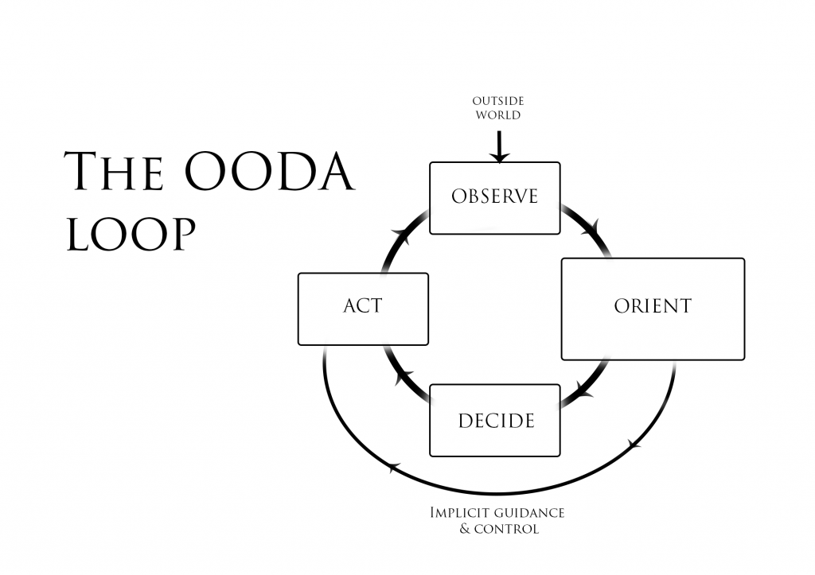
O.O.D.A. Loop

Slide 8
TRAINING
Krav Maga - IDF
CHL - Concealed Handgun License
Regular Exercise and Healthy Diet

Slide 9
PRACTICE
Perfect Practice Makes Perfect
Iron Sharpens Iron - Prov 27:17
Range Days / Include movement
Take a Deep Breath, Let it out !

Slide 10
Harden Your Position
FEBA - The area most likely to be assaulted. Fighting Positions.
Fall Back Positions
Pets - A good Dog that will protect you will be priceless.
Dead Bolts and 4 inch screws

Slide 11
Harden Your Position
Vegetation around ground level windows. Rose Bushes-Cactus
Entry Control Points
Eliminate Hiding Spots for the Enemy
Lighting

Slide 12
Christian United Church / 7530 Bandera Rd
September 10th & 11th, 2021
Day 1: Church Security Planning
Day 2: Intruder Awareness/ Response & Conflict Management
strategos.brushfire.com/2-day-church-security-training/508071
Register now and take advantage of Early Bird Pricing.

