Slide 1

The Power of the Tithe
Kingdom Building

Slide 2
learning objectives
At the end of the lesson the student will understand the biblical mandate of the tithe and offering. The blessings that accompany faithful giving. The origination of this form of worship, and how to effectively give according to the scriptures.
BOD Member.
No one on this church staff is paid.

Slide 3

My giving History
The 5 cents lesson.
Give ! or Else !!!
Reputation of Churches and giving has been rocky.
Televangelist
The early church was also plagued with the greed of false teachers who were in it for the money.
Test everything.
Your concerns are also my concerns.

Slide 4
Who Are we?
A Holy Priesthood
1 Pe 2:4 Coming to Him as to a living stone, rejected indeed by men, but chosen by God and precious,
1Pe 2:5 you also, as living stones, are being built up a spiritual house, a holy priesthood, to offer up spiritual sacrifices acceptable to God through Jesus Christ.
What are spiritual sacrifices?

Slide 5
The Book of Malachi
The standard

Slide 6
Summary of malachi
Messenger prophet
The last book of the Old Testament
Malachi means Messenger
Written between 538 - 333 bc
To the people of Judea (Mainly, The Priests)
Jews returning to the land after the Babylonian captivity were apathetic to the ways of God and The Lord reminds them of where their shortcomings stem from.
This prophetic writing is filled with End Times prophesy concerning Judgment.

Slide 7
The Lord reminds the People in Judea of the commandment they have broken. The covenant given to Levi.
Mal 2:7 “For the lips of a priest should keep knowledge (The Commandments), And people should seek the law from his (Levis’) mouth; For he is the messenger of the LORD of hosts (Armies).
Deu 10:8 At that time the LORD separated the tribe of Levi to bear the ark of the covenant of the LORD, to stand before the LORD to minister to Him and to bless in His name, to this day.
Deu 10:9 Therefore Levi has no portion nor inheritance with his brethren; the LORD is his inheritance, just as the LORD your God promised him.
Deu 10:10 ¶“As at the first time, I stayed in the mountain forty days and forty nights; the LORD also heard me at that time, and the LORD chose not to destroy you.
Deu 10:11 “Then the LORD said to me, ‘Arise, begin your journey before the people, that they may go in and possess the land which I swore to their fathers to give them.’

Slide 8
So what does that mean?
royal priesthood & The Nation of israel
The Royal Priesthood (Bible believing Christians) begin the journey into the promised land (Heaven) before the rest of Israel (Modern day Israel).
This is a hint in plain site, it is a prophetic indication of the rapture.
The purpose for the 7 year tribulation, Time of Jacobs trouble, is to refine the nation of Israel after their initial denial and rejection of Jesus Christ as Messiah.
SO, we are raptured and for 7 years, Israel goes through tribulation before they too have a chance to enter the promise land.
The Lord is our inheritance.

Slide 9
What are the Duties of the Royal Priesthood?
Tithes & Offering
Mal 3:6 “For I am the LORD, I do not change; Therefore you are not consumed, O sons of Jacob.
Mal 3:7 Yet from the days of your fathers You have gone away from My ordinances And have not kept them. Return to Me, and I will return to you,” Says the LORD of hosts. “But you said, ‘In what way shall we return?’
You have gone away from My ordinances And have not kept them. Return to Me, and I will return to you
In order to give in the manner God has instructed us we are to understand his “ordinances”. When we understand this we will understand how we “have not kept them.” and how we can fulfill his command to “Return to Me, and I will return to you”

Slide 10
Malachi 3:8-12
Do not rob god
Mal 3:8 “Will a man rob God? Yet you have robbed Me! But you say, ‘In what way have we robbed You?’ In tithes and offerings.
Mal 3:9 You are cursed with a curse, For you have robbed Me, Even this whole nation (Israel).
Mal 3:10 Bring all the tithes into the storehouse, That there may be food in My house (The Temple), And try Me now in this,” Says the LORD of hosts, “If I will not open for you the windows of heaven And pour out for you such blessing That there will not be room enough to receive it.
Mal 3:11 “And I will rebuke the devourer for your sakes, So that he will not destroy the fruit of your ground, Nor shall the vine fail to bear fruit for you in the field,” Says the LORD of hosts;
Mal 3:12 “And all nations will call you blessed, For you will be a delightful land,” Says the LORD of hosts.

Slide 11
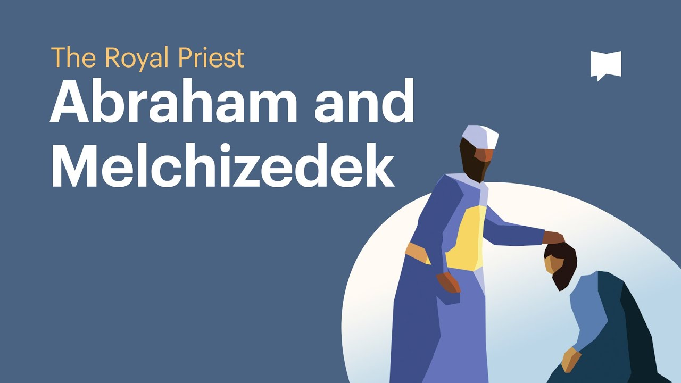
The tithe vs the offering
what is the difference?
The tithe is one 10th of your total earnings.
If your tithe is based on your net, you tithe what you get on a tax return.
If your tithe is based on your gross, you have already tithed that full amount.
Melchizedek and Abraham - Spoils of War were given to Melchizedek. Abraham tithes a 10th of the spoils of war, his earnings, to this Royal Priest. (Bible Project)

Slide 12
The Offerings
When to bring forth your offering
Leviticus 23
Every Sabbath - Sundown of Friday to sundown on Saturday
Passover
Unleavened Bread
First Fruits
Feast of weeks / Pentecost
Feast of Trumpets
Day of Atonement
Festival of Tabernacles
Freewill Offerings

Slide 13
Lev 23:2 “Speak to the children of Israel, and say to them: ‘The feasts of the LORD, which you shall proclaim to be holy convocations,(Rehersals) these are My feasts.
Please do not get confused. We are gentiles and not subject to Jewish laws, this was settled by Paul in Galatians. We also see that Jesus stated in Mark 2:27 “The Sabbath was made for man, and not man for the Sabbath.” So we are not to even consider converting to Judaism. See what Paul Says. Gal 2:16 “knowing that a man is not justified by the works of the law but by faith in Jesus Christ, even we have believed in Christ Jesus, that we might be justified by faith in Christ and not by the works of the law; for by the works of the law no flesh shall be justified.
However, concerning the Feast of Tabernacles, the bible says this. Lev 23:41 ‘You shall keep it as a feast to the LORD for seven days in the year. It shall be a statute forever in your generations…Millennial Kingdom
SO the point is that the Feast of Tabernacles is set in place for us forever, and having a greater understanding of what the Lord has in store for us, is prudent for us a Christians to learn today.
An understanding of the feast days that Jesus celebrated should bring us in closer relationship to him.

Slide 14
Ezekiel 40-48
Side Note on Millennial kingdom

Slide 15
But what about the New Testament?
Are we instructed to give tithe and offerings?
The answer is Yes. Rules to Give By.
2 Corinthians 9:7 Each one must give as he has decided in his heart, not reluctantly or under compulsion, for God loves a cheerful giver.
Luke 21:1-4 Jesus looked up and saw the rich putting their gifts into the offering box, and he saw a poor widow put in two small copper coins. And he said, “Truly, I tell you, this poor widow has put in more than all of them. For they all contributed out of their abundance, but she out of her poverty put in all she had to live on.”
Acts 20:35 In all things I have shown you that by working hard in this way we must help the weak and remember the words of the Lord Jesus, how he himself said, ‘It is more blessed to give than to receive.’”

Slide 16
1 Timothy 5:8 But if anyone does not provide for his relatives, and especially for members of his household, he has denied the faith and is worse than an unbeliever.
1 Corinthians 16:2 On the first day of every week (Sunday), each of you is to put something aside and store it up, as he may prosper, so that there will be no collecting when I come.
Mat 6:1 ¶“Take heed that you do not do your charitable deeds before men, to be seen by them. Otherwise you have no reward from your Father in heaven.
Mat 6:2 “Therefore, when you do a charitable deed, do not sound a trumpet before you as the hypocrites do in the synagogues and in the streets, that they may have glory from men. Assuredly, I say to you, they have their reward.
Mat 6:3 “But when you do a charitable deed, do not let your left hand know what your right hand is doing,
Mat 6:4 “that your charitable deed may be in secret; and your Father who sees in secret will Himself reward you openly.

Slide 17
Summary
Giving from the heart
We learned that we are a Royal Priesthood.
We learned about Malachi and how he chastised the priests in Judea for the apathetic way they were serving The Lord.
We discussed the covenant God made with Levi and how God separated them and spared them from destruction in the wilderness. We saw how they entered the promised land before the rest of the nation of Israel and the prophetic shadowing of the rapture of the church.
We learned what a tithe actual is and where it originated from (Melchizedek and Abraham) and how to effectively give our tithe in line with scripture.

Slide 18
We learned about the Lords feast days and the appropriate time in which to bring our offerings into the storehouse.
We went over Rules to Give By, that assure us of the blessing God has promised to each of us when we give in accordance with his word.

Slide 19
Repent & Believe
A dmit you are a sinner
B elieve in Jesus
C all upon his name
Time is Short

Slide 20
gasper4christianunited@gmail.com
The time is now.
If you need a Bible I will send you one.
Email me if you have any questions or comments.
Be Bold and tell someone this week about Jesus.
Visit us this Sunday at 10:30 am, 7530 Bandera Rd.
https://www.youtube.com/watch?v=KlZjA-3hiys&t=6s

